Slide 1

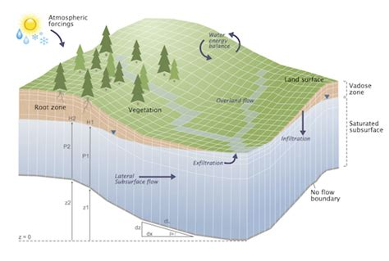
Python-PFTools tutorial
Garrett Rapp
September 22, 2020

Slide 2
Tutorials
0. Install pftools and test
Converting TCL files to Python
Run scripting
General file handling
PFB file handling
Solid files
Readthedocs: https://grapp1parflow.readthedocs.io/en/latest/python/getting_started.html

Slide 3
0. Install pftools
Clone ParFlow:
git clone https://github.com/parflow/parflow.git
Set environment variable for cloned repo:
export PARFLOW_SOURCE=/path/to/new/parflow/
Install pftools (example to virtual environment)
python3 -m venv tutorial-env
source tutorial-env/bin/activate
pip install pftools
Test your pftools installation
python3 $PARFLOW_SOURCE/test/python/base_3d/default_richards/default_richards.py

Slide 4
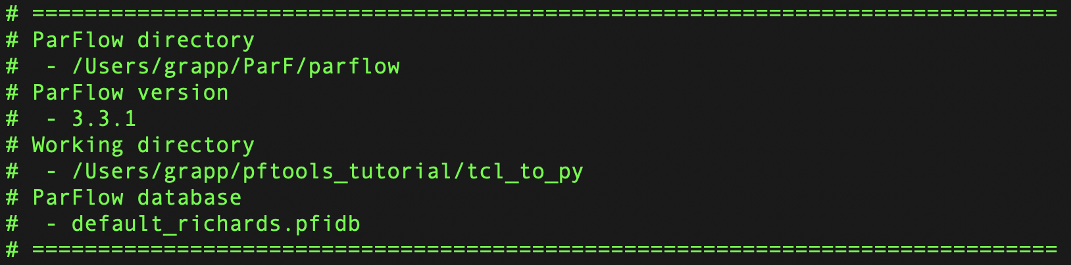

Slide 5
1. Converting TCL scripts to Python
Make a new directory and import a TCL file (example here):
mkdir -p pftools_tutorial/tcl_to_py
cd pftools_tutorial/tcl_to_py
cp $PARFLOW_SOURCE/test/default_richards.tcl .
Run the TCL conversion script on the TCL file:
python3 -m parflow.cli.tcl2py -i default_richards.tcl
Open and edit the new .py file
Test your new run
python3 default_richards.py

Slide 6
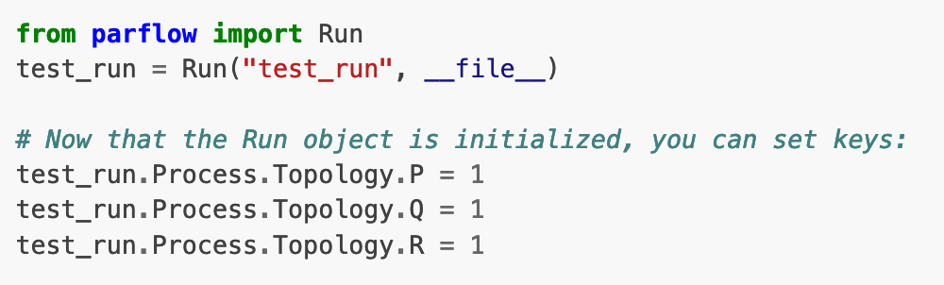
2. Run scripting - the Run class

Slide 7
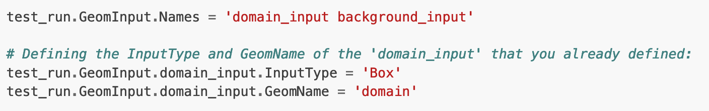
2. Run scripting - key considerations
Order is important

Slide 8
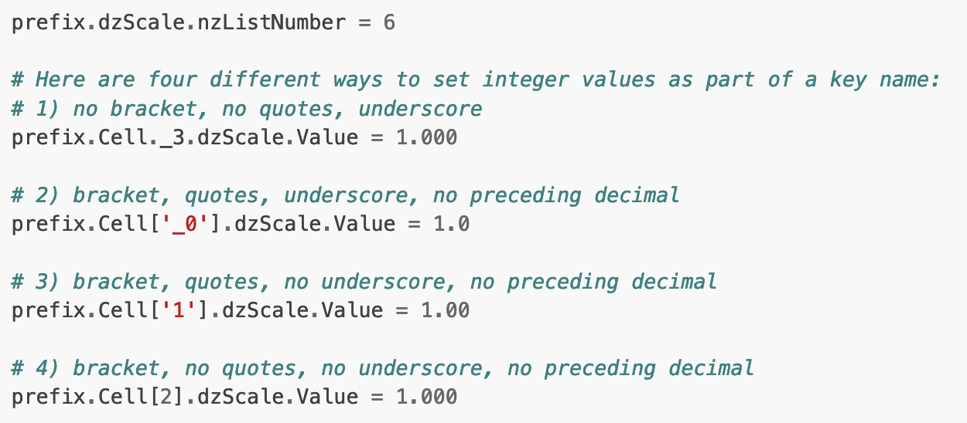
2. Run scripting - key considerations
Key names should be valid Python variables, but we allow exceptions:
Working with integer tokens using a prefix:

Slide 9
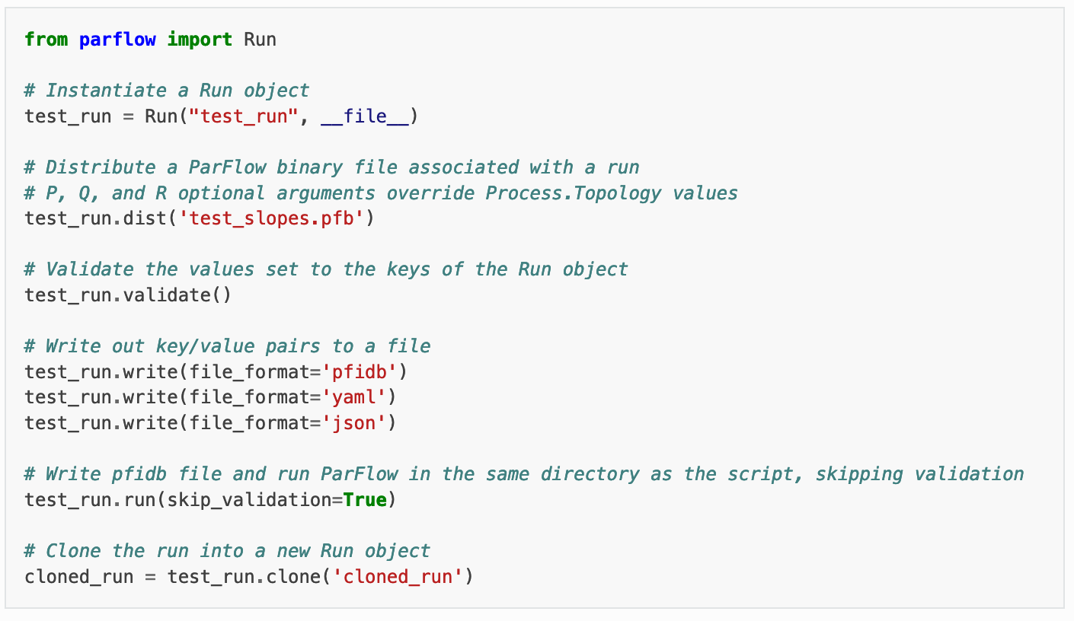
2. Run scripting - methods on the Run class

Slide 10
Try with default_richards.py
Replace default_richards.run() with the following lines:
dr_2 = default_richards.clone(‘dr_2’)
dr_2.Patch.left.BCPressure.alltime.Value = 6.0
dr_2.validate()
dr_2.write(file_format=‘yaml’)
dr_2.run(skip_validation=True)
Save and run the Python script

Slide 11
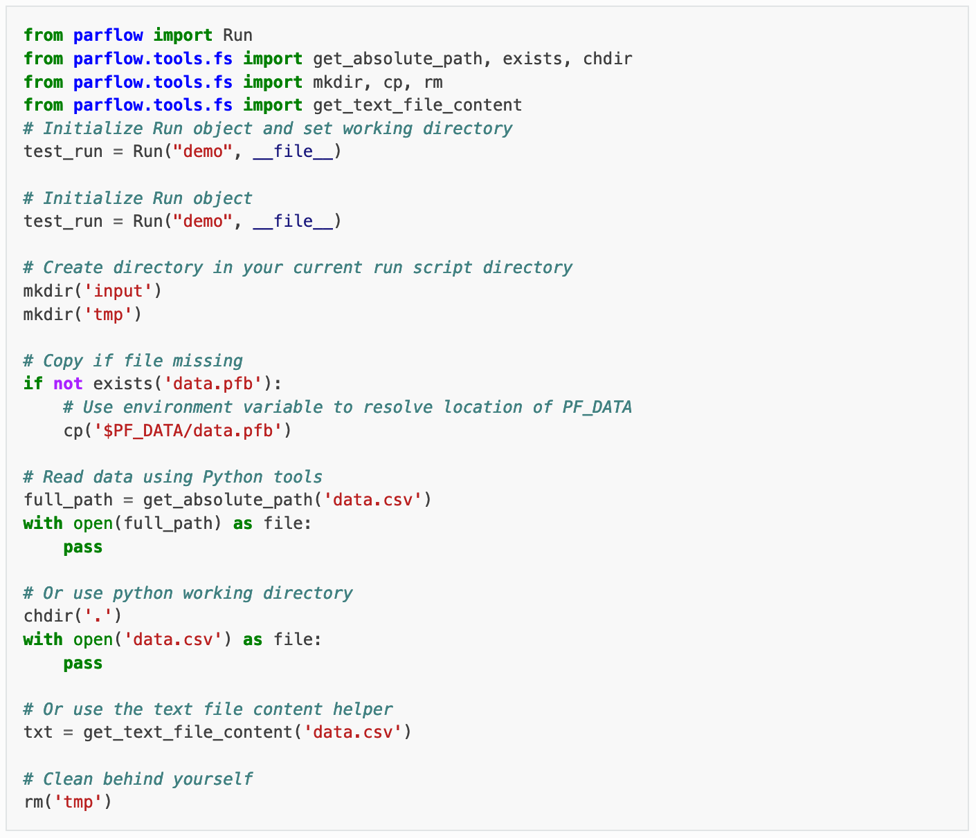
3. General file handling

Slide 12
3. General file handling

Slide 13
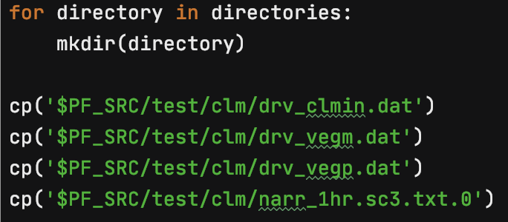
Try with clm.py
Copy the clm.py example into a new directory:
mkdir -p pftools_tutorial/fs
cd pftools_tutorial/fs
cp $PARFLOW_SOURCE/test/python/clm/clm/clm.py .

Slide 14
4. PFB file handling
Python PFTools allows us to read, write, and distribute PFB files from within a Python script.
We already saw the dist() function, which implicitly uses the parflowio module:
test_run.dist('test_slopes.pfb’)
The parflowio module allows us to do so much more!

Slide 15
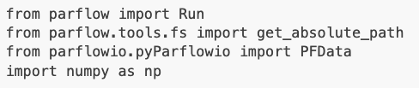
4. PFB file handling: writing
Copy the richards_FBx.py example into a new directory:
mkdir -p pftools_tutorial/pfb_test
cd pftools_tutorial/pfb_test
cp $PARFLOW_SOURCE/test/python/base/richards_FBx/richards_FBx.py .
Imported modules:
New class

Slide 16
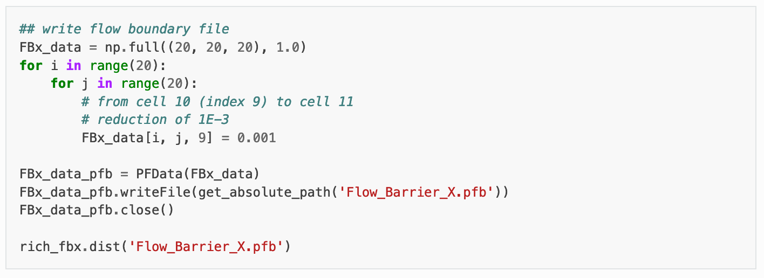
4. PFB file handling: writing
Note that the numpy array translation to a PFB file reads the dimensions as (Z, Y, X).
Instantiates PFData object from numpy array

Slide 17
4. PFB file handling: reading
Let’s read one of the output files from richards_FBx.py. Add these lines to the bottom of your script:
FBx_press_out = PFData(get_absolute_path('richards_FBx.out.press.00010.pfb')) FBx_press_out.loadHeader()
FBx_press_out.loadData()
FBx_press_out_data = FBx_press_out.getDataAsArray()
print(f'Dimensions of output file: {FBx_press_out_data.shape}') print(FBx_press_out_data)

Slide 18
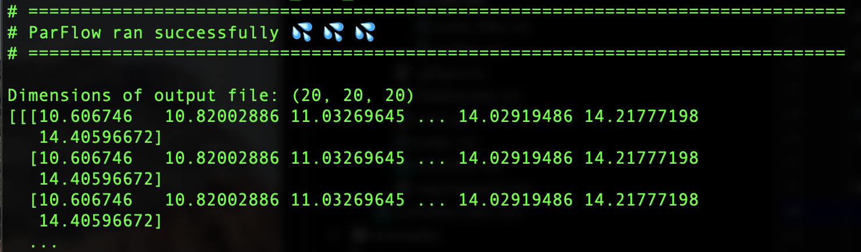
4. PFB file handling: reading
loadHeader() loads the header of the binary file
loadData() loads the data in the binary file
getDataAsArray() returns a numpy array of the data
If you save and run your script, you should see this as part of your output:

Slide 19
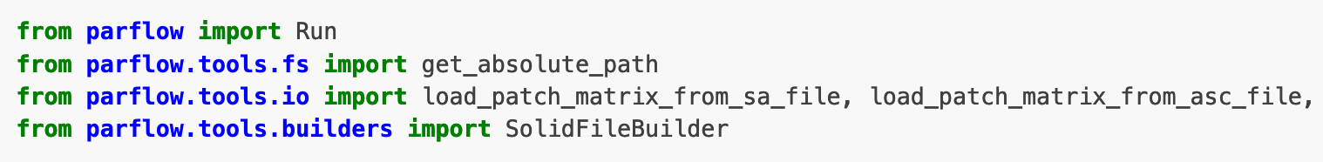
5. Solid files
Python PFTools simplifies the process to generate a solid file with the SolidFileBuilder class
Copy and open the simple_mask.py file:
mkdir -p pftools_tutorial/solid
cd pftools_tutorial/solid
cp $PARFLOW_SOURCE/test/python/pfsol/simple-mask/simple-mask.py .

Slide 20
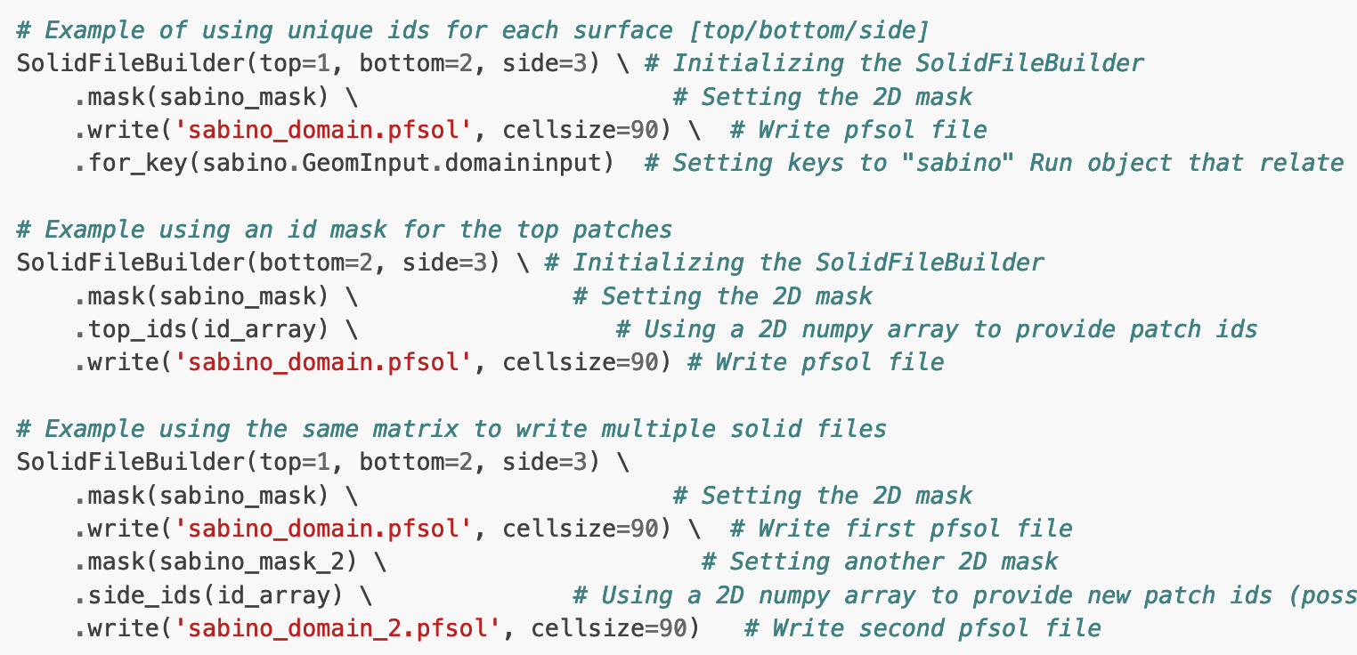
5. Solid files
Python PFTools has functions to:
Load a matrix from or write a matrix to a file
Convert a matrix to a solid file (via SolidFileBuilder class)

